Slide 1

Phar 43: QC II W/ INTRUMENTATION
LOUJESSA D. ARCELO, RPh, MS Pharm

Slide 2
GRADING SYSTEM
Pharmaceutical analysis
Quality Control System
QUIZZES
EXAMS
GRADE (100%)
30%
50%
LONG EXAM (PRE-MID/FINAL)
40%
MIDTERM/FINAL EXAM
60%
PROJECTS/ ASSIGNMENT
10%
CLASSROOM ACTIVITIES
10%
M.G. (40%)
PFG (60%)
FG (100%)
5vmutz

Slide 3

OBJECTIVES
Apply instrumental principles and techniques in pharmaceutical analysis.
Conduct control measures for pharmaceutical analysis
in-process product
microbial tests and techniques
stability testing
Show the relevance of quality assurance in the various stages of manufacture.
Notes:
Quality needs to be built from the beginning.
Quality needs to be built in, in every little task and service, by everyone participating in the process.

Slide 4
TOTAL QUALITY CONTROL SYSTEM
QUALITY MANAGEMENT
QUALITY CONTROL
QUALITY ASSURANCE
Notes:
Is an integrated organizational effort designed to improve quality at every level of the organization.
TQM aims at improving the total performance at the work place

Slide 5
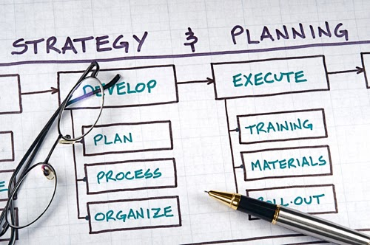

TOTAL QUALITY CONTROL SYSTEM
What is quality ?
Why is quality important ?
How can quality be improved ?

Slide 6
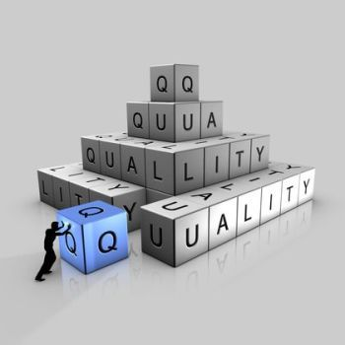
WHAT IS QUALITY ?
QUALITY
A combination of attributes or characteristics of a product, which when compared to a standard, serves as a basis for measuring the uniformity of the product and determine its degree of acceptability.
Notes:
Ability to fulfill customer’s needs and expectations.
means "degree of excellence“; implies "comparison"

Slide 7
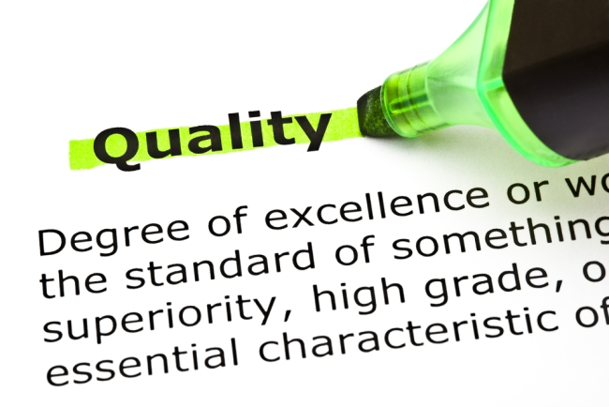
WHAT IS QUALITY ?
grade of service / product
reliability
safety
consistency
consumer's perception
Notes:
The notion of quality often entails a comparison between products. Product A is better than B and therefore has a higher quality.

Slide 8

WHAT IS QUALITY ?
FITNESS TO STANDARD
conformance to the specifications
FITNESS OF USE
conformance to the expected use
FITNESS OF COST
conformance to the expected use and to the expected price.
Notes:
FITNESS TO STANDARD: measures how well the product or service meets the targets and tolerances determined by its designers.
2. FITNESS OF USE: focuses on how well the product performs its intended function or use. It must meet the needs of a specific user group.
3. FITNESS OF COST: Value for price paid is a definition of quality that consumers often use for product or service usefulness.
- This is the only definition that combines economics with consumer criteria; it assumes that the definition of quality is price sensitive.

Slide 9
WHAT IS QUALITY ?
SUPPORT SERVICES
PSYCHOLOGICAL CRITERIA
focuses on judgmental evaluations of what constitutes product or service excellence.
the support provided after the product or service is purchased
Notes:
Support services provided are often how the quality of a product or service is judged. Quality does not apply only to the product or service itself; it also applies to the people, processes, and organizational environment associated with it.
Psychological criteria is a subjective definition that focuses on the judgmental evaluation of what constitutes product or service quality.
- For example, a hospital patient may receive average health care, but a very friendly staff may leave the impression of high quality.
- Similarly, we commonly associate certain products with excellence because of their reputation; Rolex watches and

Slide 10

WHY IS QUALITY IMPORTANT ?
Clients and consumer expect quality
Poor quality results in “REWORK” at additional cost; RECALL
Poor quality cost lives
Notes:
The reason quality has gained such prominence is that organizations have gained an understanding of the high cost of poor quality.
poor quality creates UNSATISFIED customers and eventually leads to loss of business.

Slide 11
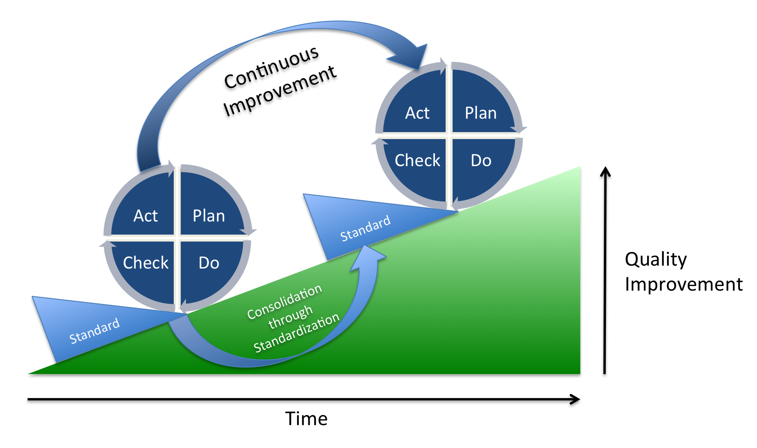
HOW CAN QUALITY BE IMPROVED?
Notes:
describes the activities a company needs to perform in order to incorporate continuous improvement in its operation.
SHEWHART Cycle: PDCA (Plan-Do-Check-Act) approach
When to Use Plan–Do–Check–Act
As a model for continuous improvement.
When developing a new or improved design of a process, product or service.
When implementing any change.
Plan. Managers must evaluate the current process and make plans based on any problems they find.
Do. implementing the plan (do).
Check: study the data collected in the previous phase. The data are evaluated to see whether the plan is achieving the goals established in the plan phase.
Act. implement the new procedure if it has been successful. Note that this is a cycle; the next step is to plan again. After we have acted, we need to continue evaluating the process, planning, and repeating the cycle again.

Slide 12
ACTIVITY…
Print the Compliance Case study and identify the following:
What was the complaint?
What was the result of the investigation?
What was the action/improvement implemented?
Was the action able to solve the problem?

Slide 13
TOTAL QUALITY MANAGEMENT
A concept, approach or tool used by manufacturing companies whereby management and labor join forces to build quality into products while helping to assure the company’s financial success.
Notes:
The basis of this approach is that organizational units should be working harmoniously to satisfy the customer.
According to John Gilbert: Total Quality Management is "A process designed to focus on customer expectations, preventing problems, building commitment to quality in the workforce and promoting open decision-making."
Requires total commitment of senior level management and supervision of all departments, operators, suppliers and customers.
Doing things right, the first time, and every time

Slide 14
TOTAL QUALITY MANAGEMENT
BASIC PRINCIPLE
Continually improve quality and service while minimizing costs and maximizing resource utilization.
Changed Emphasis
Directed towards defect prevention (proactive) rather than defect detection (after the fact).
Notes:
describes the activities a company needs to perform in order to incorporate continuous improvement in its operation

Slide 15
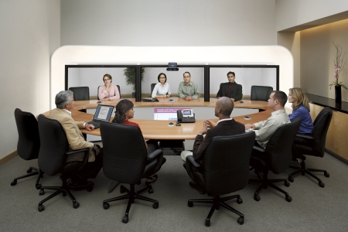
Factors affecting TQM
CUSTOMER – People (focus)
PROCESS Improvement
TOTAL Involvement
Notes:
TQM is basically for the satisfaction and welfare of customers. As a result, there will be reduction in the complaints of consumers/customers.
There is a systematic attempt to eliminate deficiencies such as production scrap or rework, customer complaints and material shortages.
TQM aims at improving the total performance at the work place.
The employees are expected to participate not only in maintaining quality but also in improving their total performance so that the wastages will be avoided, production cost will go down and the enterprise can earn more profit.

Slide 16
TOTAL QUALITY MANAGEMENT
GOAL
(SPEQ)
SAFETY
PURITY
EFFECTIVE
QUALITY

Slide 17


QUALITY assurance
Relates to the studies made and plans developed for assuring quality of a product prospectively.
Refers to a program for the systematic monitoring and evaluation of the various aspects of a project, service, or facility to ensure that standards of quality are being met.
Notes:
QA is a wide ranging concept covering all matters which individually or collectively influence the quality of a product.
GMP is that part of QA w/c ensures that products are consistently produced and controlled to the quality standards appropriate to their intended use.

Slide 18
QUALITY ASSURANCE
An overall management plan to guarantee the integrity of data (The “system”)
PRINCIPLE
Notes:
1. Ensure public recognition and credibility through the maintenance of standards

Slide 19
QA: FUNCTIONS
1
It was manufactured according to internal standards & GMPs.
The product meets all the applicable specifications
Helps to identify & prepare the necessary SOPs relative to the control of quality.
Final authority for product acceptance or rejection.
Serves as contact with regulatory agencies, like FDA, DOH.
Responsible for assuring quality policies are followed.
Notes:
This is a part of quality management system focused on the fulfilment of quality requirements and providing confidence of meeting customer requirements.
SOPs play an important role in quality system.

Slide 20
QA: FUNCTIONS
2
Quality Monitoring or Auditing
Determines that the procedures are current and correct.
Procedures are being followed by properly trained operators.
Determines whether the equipment, facilities and operations are adequate and conforms to standards set by regulatory agencies.
Continually assess operations w/in the organization.
As advisory toward full compliance w/ all applicable internal & external regulations.

Slide 21
QUALITY CONTROL
A tool which gives the assurance that a product conforms to standards and specifications through a system of inspection, analysis, and action.
Notes:
Part of a quality management system focused on the operational techniques and processes used to fulfil quality requirements.

Slide 22
QUALITY control
PRINCIPLE
A series of analytical measurements used to assess the quality of the analytical data (The “tools”)
Notes:
Process employed to ensure a certain level of quality in a product or service.

Slide 23
QC: FUNCTIONS
1
2
3
4
Sampling, inspection and testing of incoming RM, packaging, & labeling components
Physical inspection of product and operations at the critical intermediate stages (in-process)
Perform environmental monitoring.
Conduct required test on the FP.
Notes:
Responsible for the day-to-day control of quality in a company
Packaging & labeling components must be inspected and tested against rigid specifications to assure that they meet predetermined functional standards.
Labeling in the most critical component.
Sample and test products at various critical steps in production against criteria previously established.
Assures the quality and stability of the product by preventing the products from being exposed to a hostile environment.
For Sterile product: Parenteral and Ophthalmic products must be produced in a controlled environment designed to protect their sterility. Monitoring of air and water systems
For Non-sterile products: Liquids, tablets, capsules – must be manufactured under strict but acceptable limits of particulate & microbial matters.

Slide 24
QUALITY CONTROL
QUALITY CONTROL
MATERIALS INSPECTION SECTION
ANALYTICAL LABORATORY
BIOLOGICAL TESTING LABORATORY
SPECIFICATIONS AND ANALYTICAL DEVELOPMENT
QUALITY COORDINATING OFFICE
Notes:
QC DEPARTMENT
MATERIALS INSPECTION SECTION
Inspectors are alert individuals who had experience and who are familiar with the physical characteristics of the materials they sample and are well versed in sampling techniques. The functions of this section are:
To sample and examine all raw materials received.
To sample and conduct physical test on:
All shipments of packaging materials
All manufacturing, filling, and packaging operations.
ANALYTICAL LABORATORY
Should be in an accessible area and protected from noise and vibration common to manufacturing operations.
In order to perform physical and chemical analysis,
BIOLOGICAL TESTING LABORATORY
The staff in biological testing laboratory should be well trained and experienced in both simple and complex microbiological procedures and biological interactions.
SPECIFICATIONS AND ANALYTICAL DEVELOPMENT
To develop and improve specifications for quality characteristics of the final product being manufactured.
QUALITY COORDINATION OFFICE
This section should be accessible to all manufacturing and packaging operations since documentation is its main stability.
To maintain and store records that represent the history of the batch from start to finish.

Slide 25

QA vs. QC

Slide 26
ACTIVITY!!!
Process
Proactive
Prevent defects
Product
Reactive
Find defects

Slide 27
QC vs. QA
Product
Reactive
Find defects
Process
Proactive
Prevent defects

